Slide 1




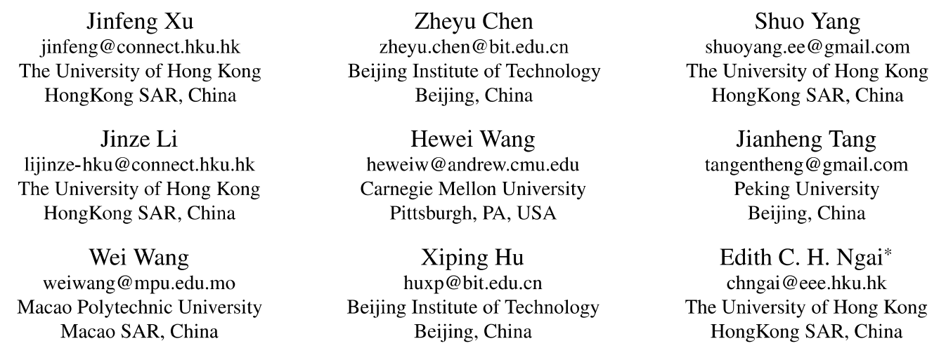





ATAI
Advanced Technique of Artificial Intelligence
ATAI
ChongqingUniversity _{AdvancedTechniqueof}
of Technology Artificial Intelligence
Chongqing University of
Technology
Chongqing University ^{ATAI}
_{of Technology} Advanced Techniqueof
Artificial Intelligence
Chongqing University of Technology
Chongqing University of Technology
Well Begun is Half Done: Training-Free and Model-Agnostic
Semantically Guaranteed User Representation Initialization for
Multimodal Recommendation
Code: https://github.com/Jinfeng-Xu/SG-URInit
—— SIGIR_2026
Reported by Langxu Li
1

Slide 2
ATAI
Advanced Technique of Artificial Intelligence
ATAI
ChongqingUniversity _{AdvancedTechniqueof}
of Technology Artificial Intelligence
Chongqing University of
Technology
Chongqing University ^{ATAI}
_{of Technology} Advanced Techniqueof
Artificial Intelligence
Chongqing University of Technology
Chongqing University of Technology
Motivation
(1) Existing multimodal recommendation methods overlook the critical role of user representation initialization.
(2) Unlike items enriched with modality information, user representations are typically randomly initialized, creating a significant semantic gap between user and item embeddings. This gap introduces noise during graph convolution, hindering the learning of effective representations.

Slide 3
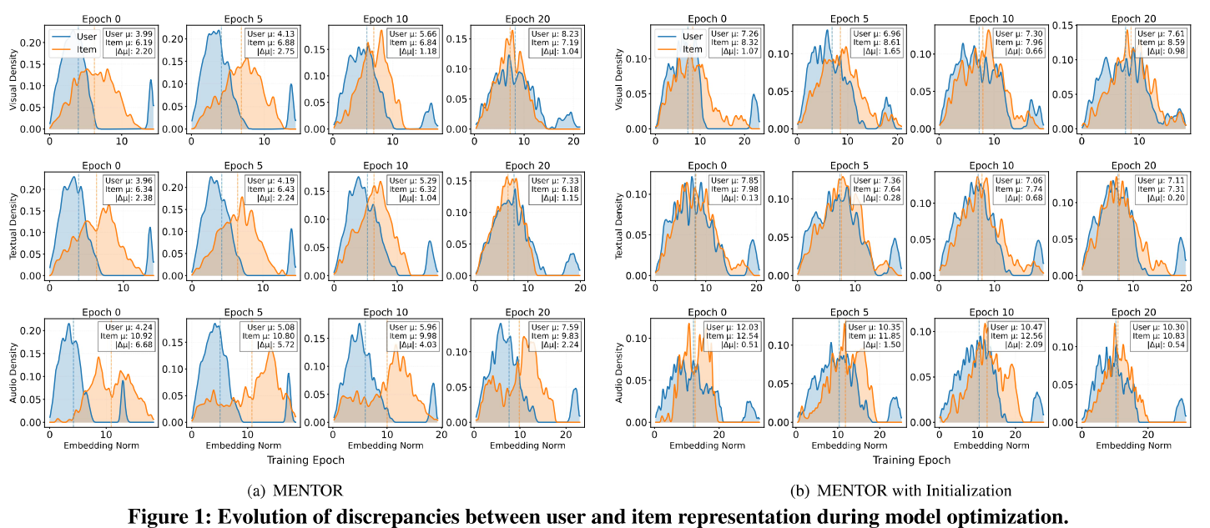
ATAI
Advanced Technique of Artificial Intelligence
ATAI
ChongqingUniversity _{AdvancedTechniqueof}
of Technology Artificial Intelligence
Chongqing University of
Technology
Chongqing University ^{ATAI}
_{of Technology} Advanced Techniqueof
Artificial Intelligence
Chongqing University of Technology
Chongqing University of Technology
Motivation

Slide 4
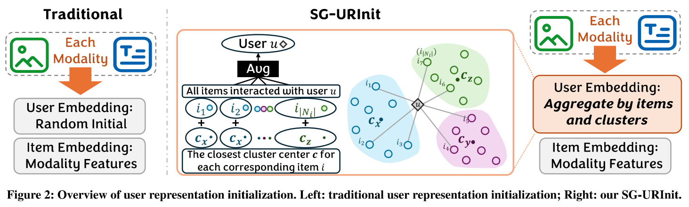
ATAI
Advanced Technique of Artificial Intelligence
ATAI
ChongqingUniversity _{AdvancedTechniqueof}
of Technology Artificial Intelligence
Chongqing University of
Technology
Chongqing University ^{ATAI}
_{of Technology} Advanced Techniqueof
Artificial Intelligence
Chongqing University of Technology
Chongqing University of Technology
Method

Slide 5




ATAI
Advanced Technique of Artificial Intelligence
ATAI
ChongqingUniversity _{AdvancedTechniqueof}
of Technology Artificial Intelligence
Chongqing University of
Technology
Chongqing University ^{ATAI}
_{of Technology} Advanced Techniqueof
Artificial Intelligence
Chongqing University of Technology
Chongqing University of Technology
Method

Slide 6
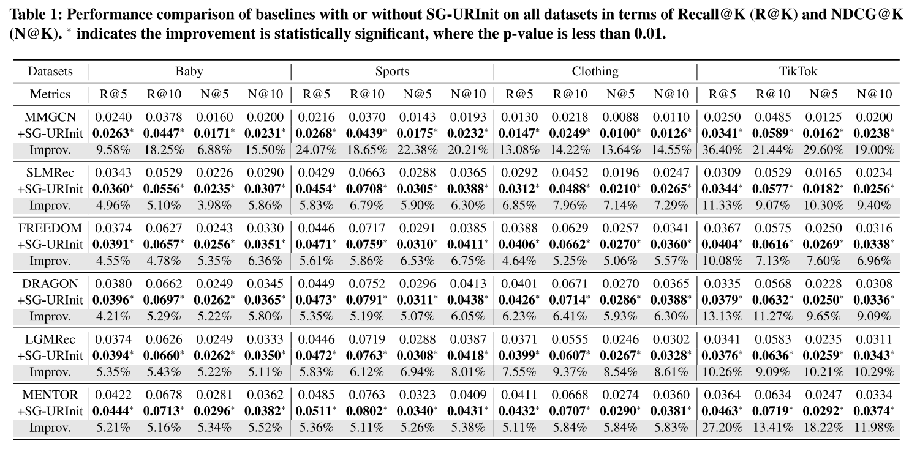
ATAI
Advanced Technique of Artificial Intelligence
ATAI
ChongqingUniversity _{AdvancedTechniqueof}
of Technology Artificial Intelligence
Chongqing University of
Technology
Chongqing University ^{ATAI}
_{of Technology} Advanced Techniqueof
Artificial Intelligence
Chongqing University of Technology
Chongqing University of Technology
Experiments

Slide 7
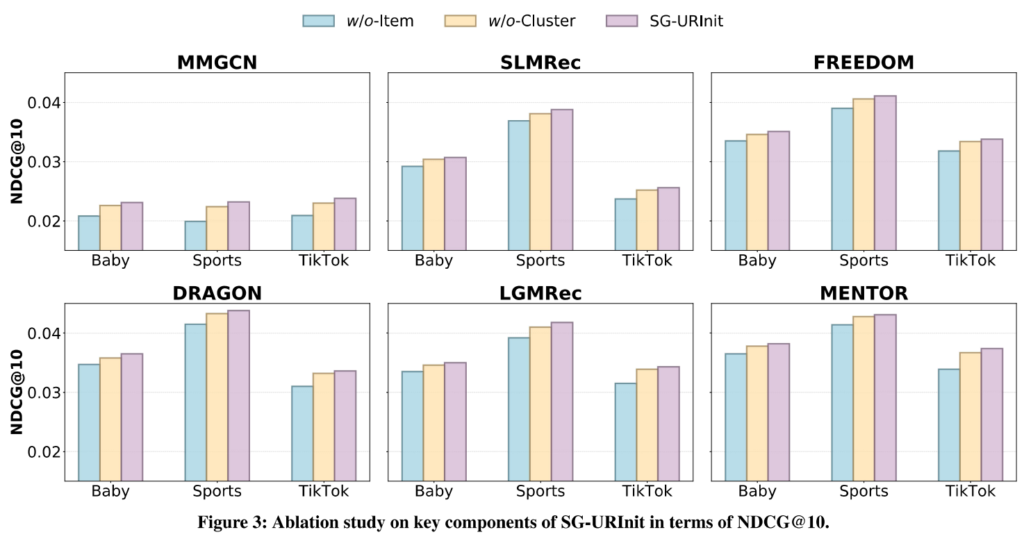
ATAI
Advanced Technique of Artificial Intelligence
ATAI
ChongqingUniversity _{AdvancedTechniqueof}
of Technology Artificial Intelligence
Chongqing University of
Technology
Chongqing University ^{ATAI}
_{of Technology} Advanced Techniqueof
Artificial Intelligence
Chongqing University of Technology
Chongqing University of Technology
Experiments

Slide 8
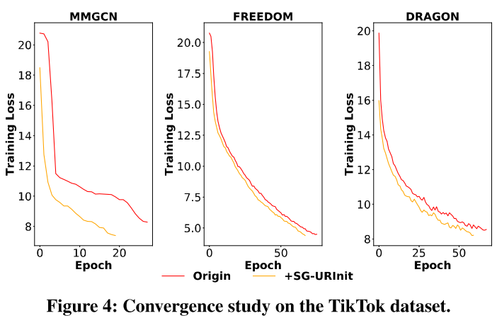
ATAI
Advanced Technique of Artificial Intelligence
ATAI
ChongqingUniversity _{AdvancedTechniqueof}
of Technology Artificial Intelligence
Chongqing University of
Technology
Chongqing University ^{ATAI}
_{of Technology} Advanced Techniqueof
Artificial Intelligence
Chongqing University of Technology
Chongqing University of Technology
Experiments

Slide 9
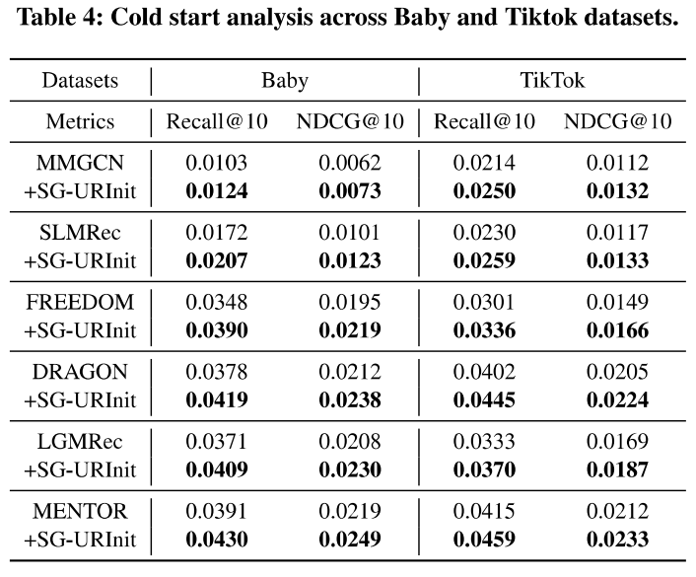
ATAI
Advanced Technique of Artificial Intelligence
ATAI
ChongqingUniversity _{AdvancedTechniqueof}
of Technology Artificial Intelligence
Chongqing University of
Technology
Chongqing University ^{ATAI}
_{of Technology} Advanced Techniqueof
Artificial Intelligence
Chongqing University of Technology
Chongqing University of Technology
Experiments

Slide 10
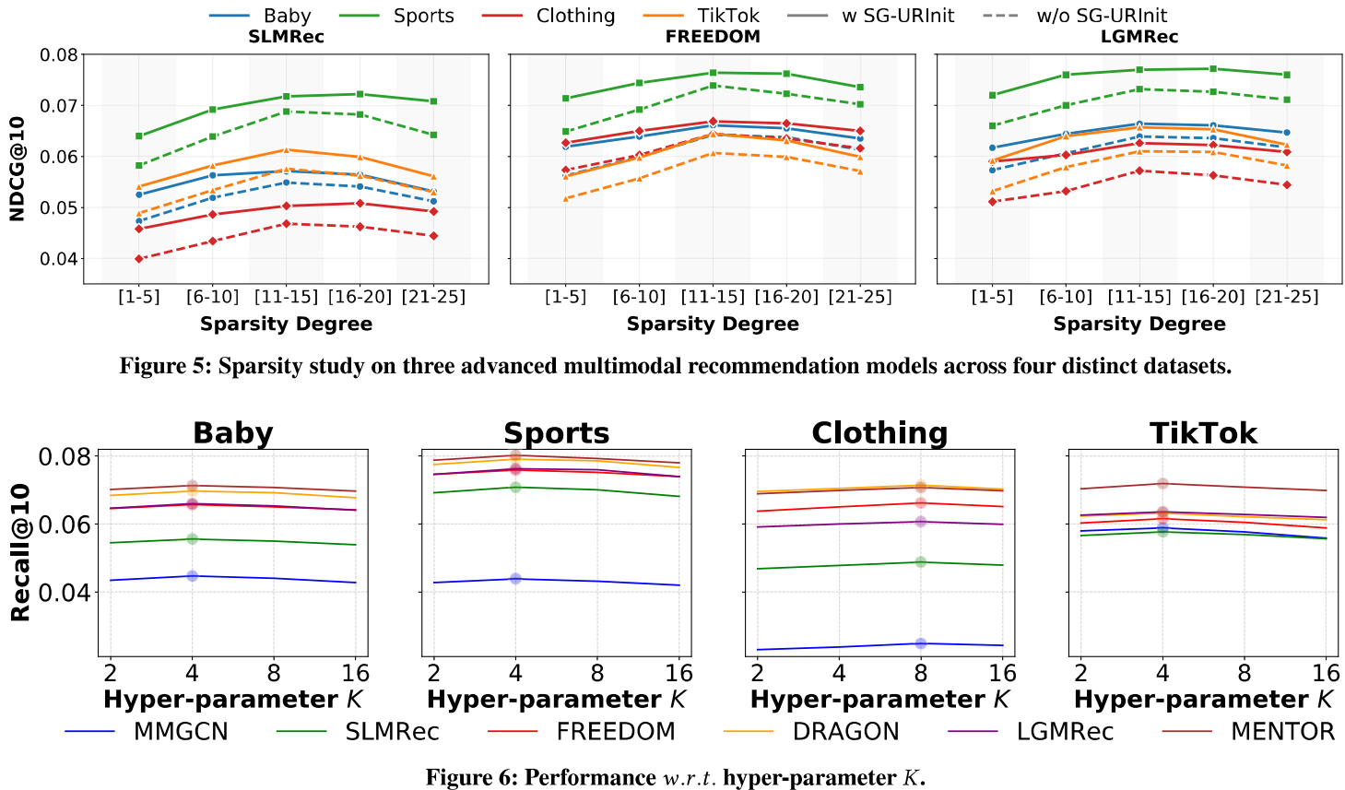
ATAI
Advanced Technique of Artificial Intelligence
ATAI
ChongqingUniversity _{AdvancedTechniqueof}
of Technology Artificial Intelligence
Chongqing University of
Technology
Chongqing University ^{ATAI}
_{of Technology} Advanced Techniqueof
Artificial Intelligence
Chongqing University of Technology
Chongqing University of Technology
Experiments

Slide 11
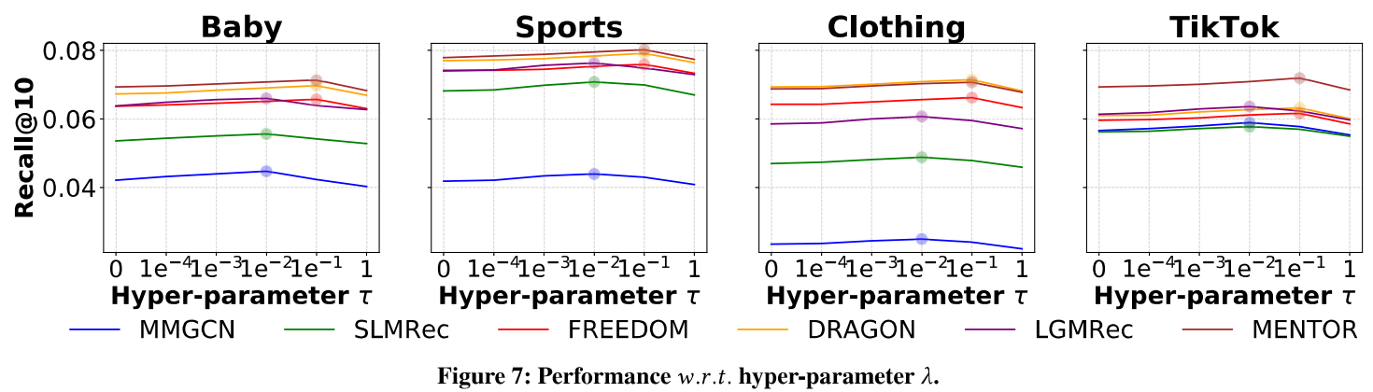
ATAI
Advanced Technique of Artificial Intelligence
ATAI
ChongqingUniversity _{AdvancedTechniqueof}
of Technology Artificial Intelligence
Chongqing University of
Technology
Chongqing University ^{ATAI}
_{of Technology} Advanced Techniqueof
Artificial Intelligence
Chongqing University of Technology
Chongqing University of Technology
Experiments

Slide 12


ATAI
Advanced Technique of Artificial Intelligence
ATAI
ChongqingUniversity _{AdvancedTechniqueof}
of Technology Artificial Intelligence
Chongqing University of
Technology
Chongqing University ^{ATAI}
_{of Technology} Advanced Techniqueof
Artificial Intelligence
Chongqing University of Technology
Chongqing University of Technology
Thanks!

